Slide 1
Acids and Bases Year 9 Science Revision

Slide 2
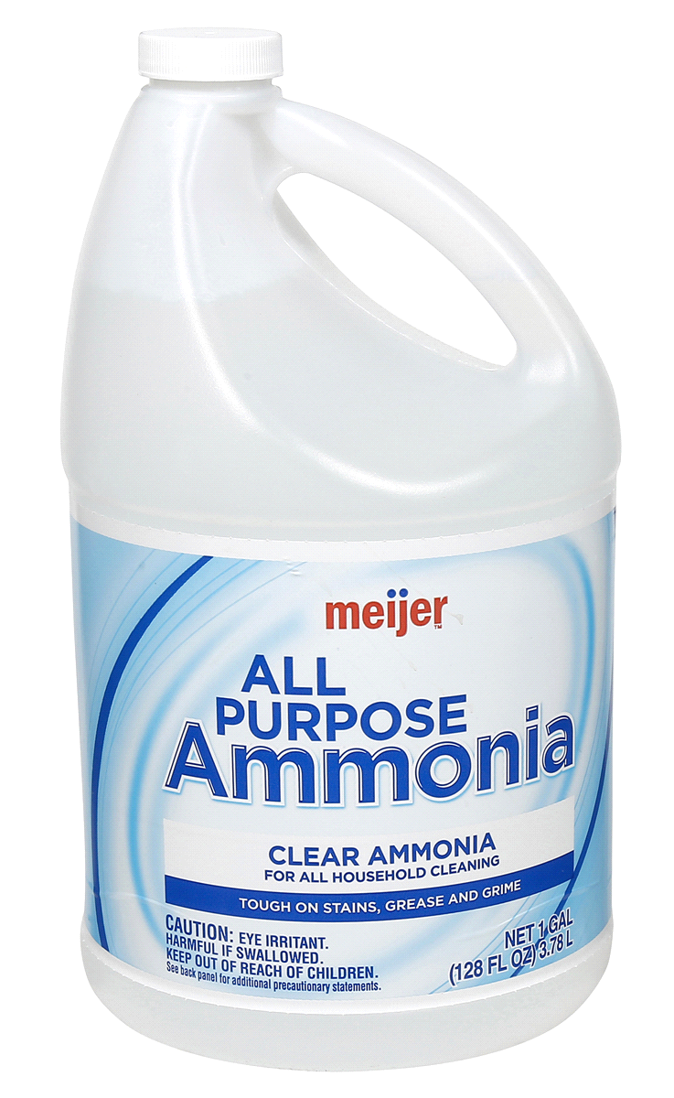
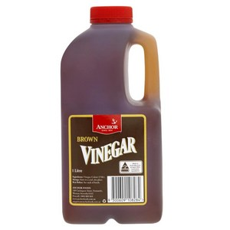
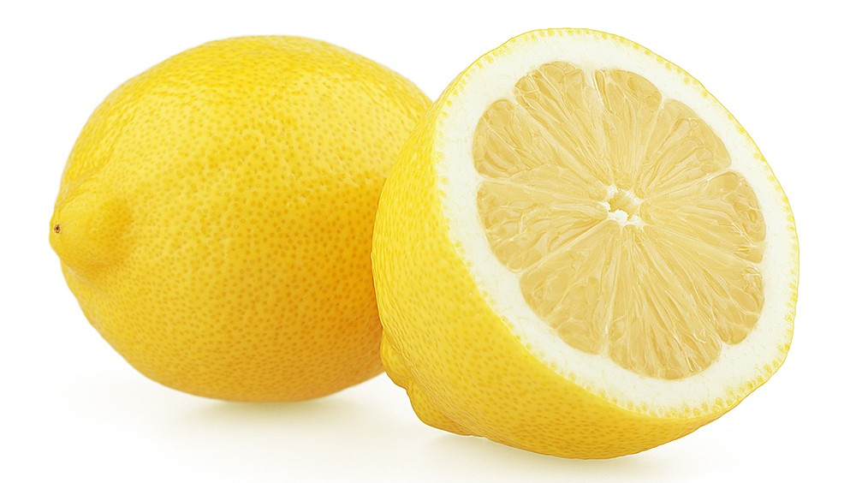
Concept Development
Acids and Bases
Acids and bases are groups of chemical compounds.
Each group has their own chemical properties.
Acids and bases have different uses, for example:
Acids are often used in cooking.
Bases can be used for cleaning and manufacturing other materials.

Slide 3
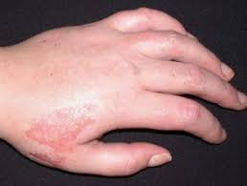
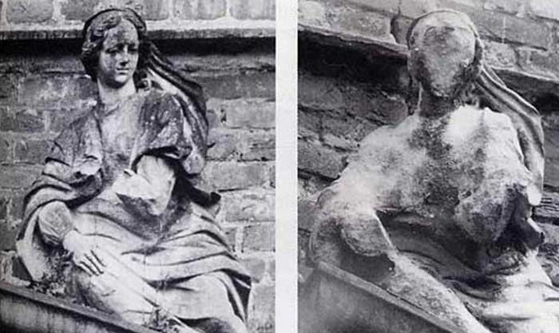
Concept Development
Acids
Acids are a group of chemical compounds, which have similar properties.
The common properties of acids are:
They have a sour taste
They produce a prickling or burning sensation in contact with skin
They are corrosive (eat away at other substances)
Acids contain hydrogen (H) in their chemical structure.

Slide 4

Concept Development
Acids
Acids can be strong or weak.
Strong acids are corrosive and can burn through objects.
Some strong acids are hydrochloric acid (HCl) in your stomach and nitric acid (HNO₃) used make fertilisers.
Weak acids are usually safer and often found in food.
Some weak acids are citric acid in citrus fruit and lactic acid found in dairy products.

Slide 5
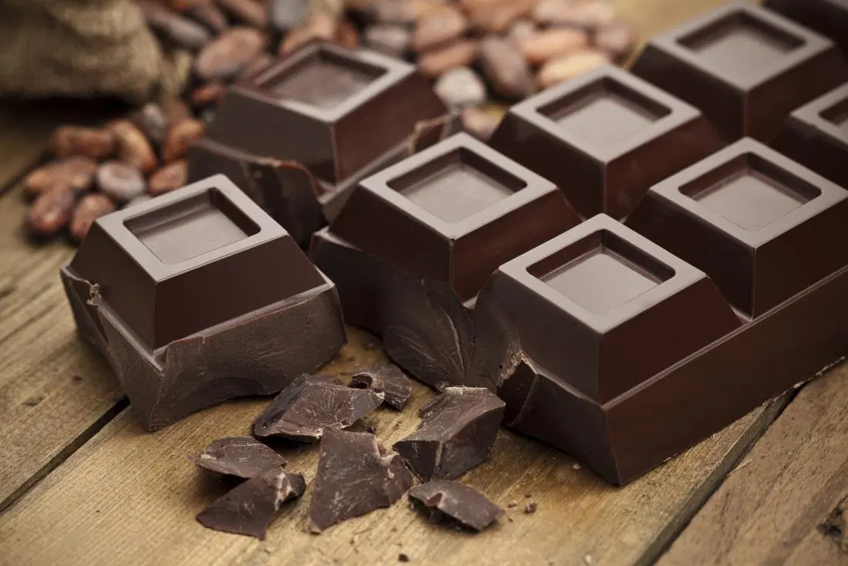

Concept Development
Bases
Bases are a group of chemical compounds, which have similar properties.
The common properties of bases are:
They have a bitter taste
They feel slippery or soapy to touch
They are corrosive (eat away at other substances)
Many bases contain hydroxide (OH) or carbonate (CO₃) in their chemical structure.

Slide 6
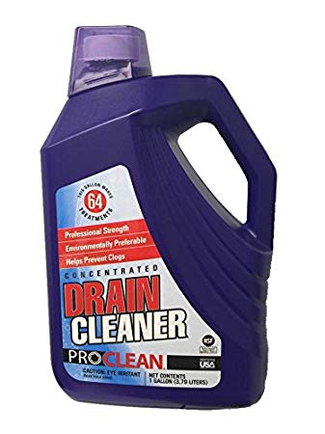
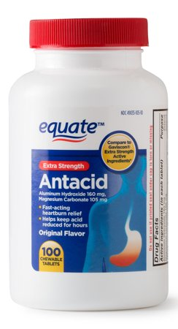
Concept Development
Bases
Bases can be strong or weak.
Strong bases are corrosive and can burn through objects.
Some strong bases are sodium hydroxide (NaOH) found in drain cleaner and calcium hydroxide (Ca(OH)₂) used in concrete.
Weak bases are safer and often found in food or used as cleaning products.
Some weak bases are used as antacids and sodium carbonate (Na₂CO₃) in washing powders.

Slide 7
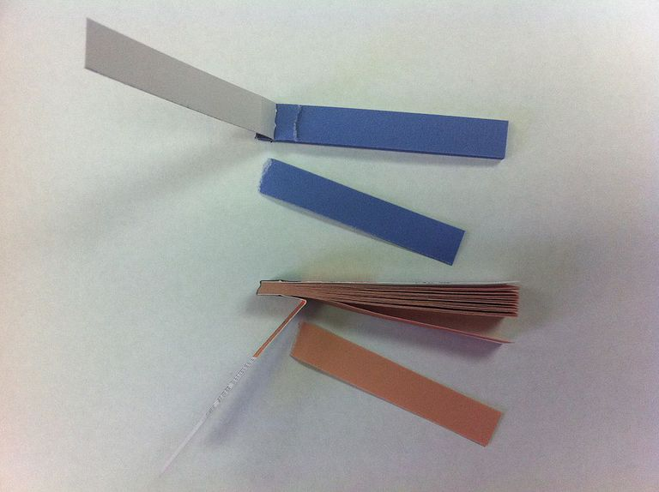

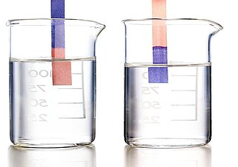
Concept Development
Identifying Acids and Bases Using Indicators
Indicator are chemicals that change colour in the presence of acids and bases.
A common indicator is litmus paper, which turns red in acids and blue in bases.
Many plant materials make good indicators. The colour of hydrangeas depends on how acidic or basic the soil is.

Slide 8
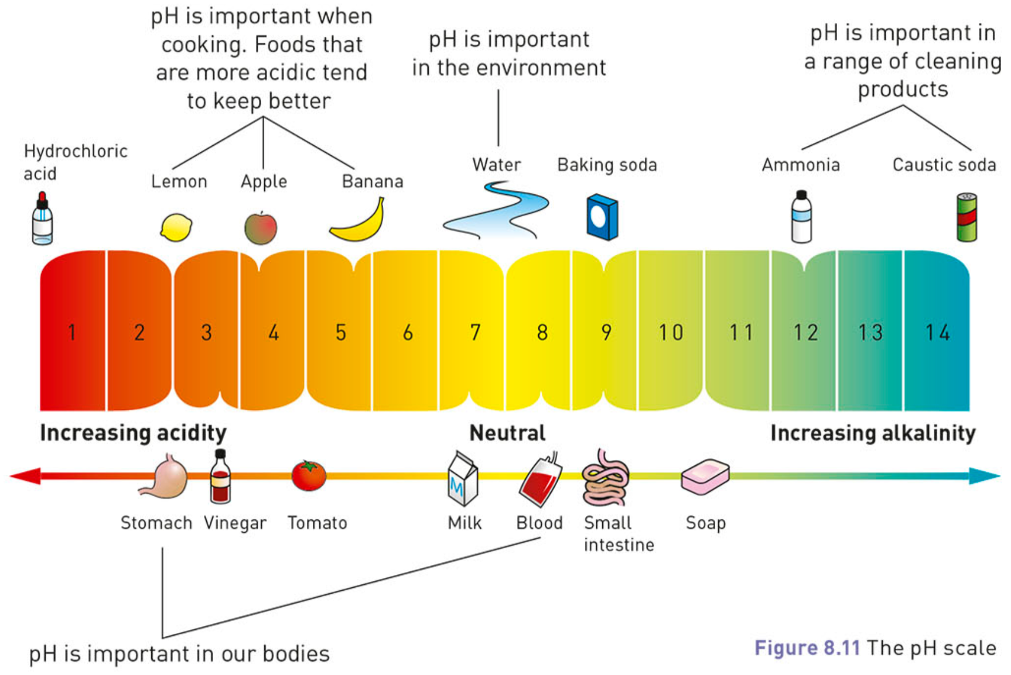
Concept Development
pH Scale and Universal Indicator
The pH scale is used to compare how acidic or basic different substances are.
If a substance is neutral, it has a pH of 7, for example pure water.
Acidic substances have a pH of less than 7.
A stronger acid has a lower pH.
Basic substances have a pH of more than 7.
A stronger base has a higher pH.

Slide 9

Concept Development
pH Scale and Universal Indicator
Universal indicator is a mixture of indicators and can be used in solution or paper form.
It gives a more accurate indication of how acidic or basic a substance is.
Universal indicator changes colour depending on the pH of the substance and is compared to a colour chart.

Slide 10
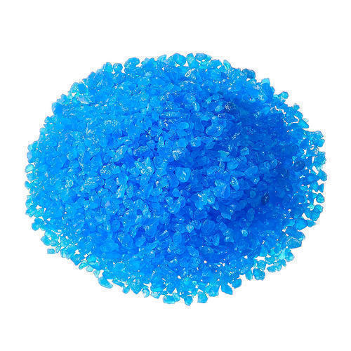
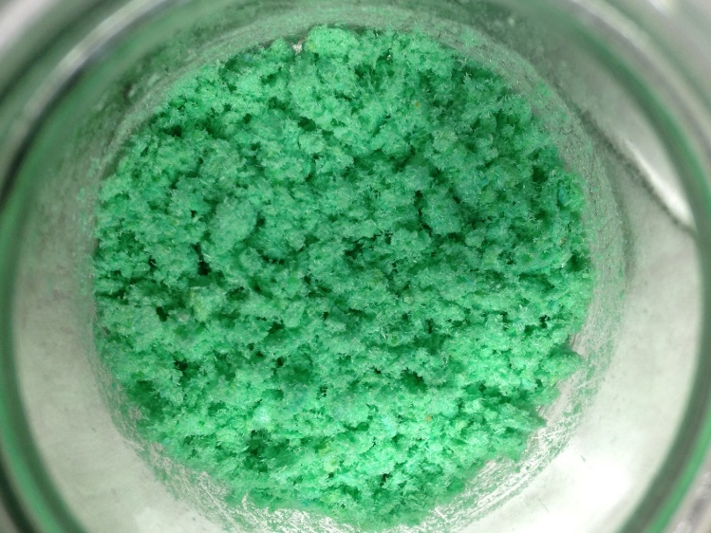
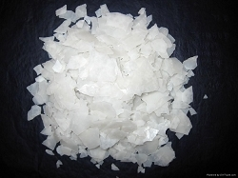
Concept Development
Salts
In our everyday language, the word salt refers to the stuff we put on our food to make it taste better.
To a scientist, the term salt refers to any compound made from a metal and a non-metal (or group of non-metals).
Magnesium chloride (MgCl₂), copper chloride (CuCl₂), and copper sulfate (CuSO₄) are all salts.

Slide 11
Concept Development
Reaction of Acids with Metals
Acids react with metals in a predictable way.
When an acid reacts with a metal, hydrogen gas is produced.
The hydrogen gas is formed from the hydrogen in the acid.
The other part of the acid reacts with the metal to form a salt.
For example:
Magnesium + hydrochloric acid → hydrogen + magnesium chloride
Mg + 2HCl → H₂ + MgCl₂
The hydrogen gas has formed from the hydrogen in the acid.
The magnesium chloride has formed from the metal, and the chlorine in the acid.

Slide 12
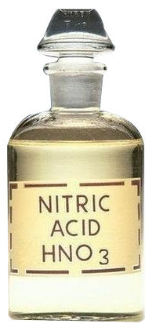
Concept Development
Reaction of Acids with Metals
Different acids form different salts.
Hydrochloric acid forms chloride salts, eg sodium chloride.
Nitric acid forms nitrate salts, eg sodium nitrate.
Sulfuric acid forms sulfate salts, eg sodium sulfate.
Ethanoic acid (vinegar) forms ethanoate salts, eg sodium ethanoate.

Slide 13
Concept Development
Testing for Hydrogen
The common test for hydrogen is called the ‘pop test’.
A sample of the gas is collected in a test tube.
A lit match or splint is held at the mouth of the test tube.
If hydrogen is present, a squeaky sound is heard when the hydrogen burns.

Slide 14
Skill Development / Guided Practice
Writing Word Equations for Acid-Metal Reactions
Identify the reactants in the reaction and write them first, with plus signs between each one.
Write an arrow at the end of the reactants, and put the hydrogen on the products side.
Identify the salt formed and add it to the products side.
Predict the products when iron reacts with hydrochloric acid.
Reminder
Hydrochloric acid forms chloride salts Nitric acid forms nitrate salts Sulfuric acid forms sulfate salts Ethanoic acid (vinegar) forms ethanoate salts
Reactants
Iron + Hydrochloric acid
Products
Hydrogen +
→
Iron chloride

Slide 15
Skill Development / Guided Practice
Writing Word Equations for Acid-Metal Reactions
Identify the reactants in the reaction and write them first, with plus signs between each one.
Write an arrow at the end of the reactants, and put the hydrogen on the products side.
Identify the salt formed and add it to the products side.
What products are formed when zinc and nitric acid react together?
Reminder
Hydrochloric acid forms chloride salts Nitric acid forms nitrate salts Sulfuric acid forms sulfate salts Ethanoic acid (vinegar) forms ethanoate salts
Reactants
Zinc + Nitric acid
Products
Hydrogen +
→
Zinc nitrate

Slide 16
Skill Development / Guided Practice
Writing Word Equations for Acid-Metal Reactions
Identify the reactants in the reaction and write them first, with plus signs between each one.
Write an arrow at the end of the reactants, and put the hydrogen on the products side.
Identify the salt formed and add it to the products side.
When sulfuric acid and copper react together, what products would be formed?
Reminder
Hydrochloric acid forms chloride salts Nitric acid forms nitrate salts Sulfuric acid forms sulfate salts Ethanoic acid (vinegar) forms ethanoate salts
Reactants
Copper + Sulfuric acid
Products
Hydrogen +
→
Copper sulfate

Slide 17
Concept Development
Hydroxide Bases
Many bases contain a group of non-metal atoms called a hydroxide.
A hydroxide made from an oxygen atom and a hydrogen atom joined together (OH).
Some examples of hydroxide bases are:
Sodium hydroxide, NaOH – used in drain cleaner
Calcium hydroxide, Ca(OH)₂ – used in paper production
Magnesium hydroxide, Mg(OH)₂ – used in antacids

Slide 18
Concept Development
Carbonate Bases
Many bases contain a group of non-metal atoms called a carbonate.
A carbonate is made from three oxygen atoms and a carbon atom joined together (CO₃).
Some examples of carbonate bases are:
Magnesium carbonate MgCO₃ – used in antacids
Calcium carbonate, CaCO₃ – found in limestone

Slide 19
Concept Development
Reaction of Acids with Bases
When an acid reacts with either type of base, water and a salt is produced.
The water is formed from the hydrogen in the acid reacting with oxygen from the base.
The other part of the acid reacts with the metal from the base to form a salt.
Carbonate bases also produce carbon dioxide from the carbon and oxygen in the carbonate.

Slide 20
Concept Development
Reaction of Acids with Hydroxide Bases
For example:
Sodium hydroxide + hydrochloric acid → water + sodium chloride
NaOH + HCl → H₂O + NaCl
Water forms from hydrogen in the acid and hydroxide from the base.
Sodium chloride forms from the metal in the hydroxide and the chlorine in the acid.
This type of reaction is called neutralisation, because water is formed which is a neutral substance.

Slide 21
Concept Development
Testing for Neutralisation
When an acid and a hydroxide base react, they form water and a salt.
Both the water and the salt are neutral substances.
Universal indicator can be used to show the pH of the reaction.
When the acid and hydroxide base are neutralised, the universal indicator will be green.

Slide 22
Concept Development
Reaction of Acids with Carbonate Bases
For example:
Sodium carbonate + hydrochloric acid → water + carbon dioxide + sodium chloride
2NaCO₃ + 2HCl → H₂O + 2CO₂ + 2NaCl
Carbon dioxide comes from the carbonate.
Water forms from the hydrogen in the acid and an oxygen from the carbonate in the base.
The sodium chloride has formed from the metal in the carbonate and the chlorine in the acid.

Slide 23
Concept Development
Testing for Carbon Dioxide
When an acid and a carbonate base react, they form water, carbon dioxide and a salt.
We can test for carbon dioxide using a substance called limewater.
The gas produced is bubbled through limewater, which turns cloudy if carbon dioxide is present.

Slide 24
Skill Development / Guided Practice
Reminder
Hydrochloric acid forms chloride salts Nitric acid forms nitrate salts Sulfuric acid forms sulfate salts Ethanoic acid (vinegar) forms ethanoate salts
Writing Word Equations for Acid-Base Reactions
Write the reactants first, followed by an arrow.
Write the water on the products side.
Identify the salt formed and add it to the products side.
Add carbon dioxide to the products side for carbonate reactions.
Predict the products when zinc hydroxide reacts with hydrochloric acid.
Reactants
Zinc hydroxide + Hydrochloric acid
Products
Water +
→
Zinc chloride

Slide 25
Skill Development / Guided Practice
Reminder
Hydrochloric acid forms chloride salts Nitric acid forms nitrate salts Sulfuric acid forms sulfate salts Ethanoic acid (vinegar) forms ethanoate salts
Writing Word Equations for Acid-Base Reactions
Write the reactants first, followed by an arrow.
Write the water on the products side.
Identify the salt formed and add it to the products side.
Add carbon dioxide to the products side for carbonate reactions.
Predict the products when copper hydroxide reacts with sulfuric acid.
Reactants
Copper hydroxide + Sulfuric acid
Products
Water +
→
Copper sulfate

Slide 26
Skill Development / Guided Practice
Reminder
Hydrochloric acid forms chloride salts Nitric acid forms nitrate salts Sulfuric acid forms sulfate salts Ethanoic acid (vinegar) forms ethanoate salts
Writing Word Equations for Acid-Base Reactions
Write the reactants first, followed by an arrow.
Write the water on the products side.
Identify the salt formed and add it to the products side.
Add carbon dioxide to the products side for carbonate reactions.
Predict the products when iron carbonate reacts with hydrochloric acid.
Reactants
Iron carbonate + Hydrochloric acid
Products
Water + Carbon dioxide +
→
Iron chloride

Slide 27
Skill Development / Guided Practice
Reminder
Hydrochloric acid forms chloride salts Nitric acid forms nitrate salts Sulfuric acid forms sulfate salts Ethanoic acid (vinegar) forms ethanoate salts
Writing Word Equations for Acid-Base Reactions
Write the reactants first, followed by an arrow.
Write the water on the products side.
Identify the salt formed and add it to the products side.
Add carbon dioxide to the products side for carbonate reactions.
Predict the products when zinc carbonate reacts with nitric acid.
Reactants
Zinc carbonate + Nitric acid
Products
Water + Carbon dioxide +
→
Zinc nitrate

Slide 28
Skill Development / Guided Practice
Reminder
Hydrochloric acid forms chloride salts Nitric acid forms nitrate salts Sulfuric acid forms sulfate salts Ethanoic acid (vinegar) forms ethanoate salts
Writing Word Equations for Acid-Base Reactions
Write the reactants first, followed by an arrow.
Write the water on the products side.
Identify the salt formed and add it to the products side.
Add carbon dioxide to the products side for carbonate reactions.
Predict the products when sodium hydroxide reacts with ethanoic acid.
Reactants
Sodium hydroxide + Ethanoic acid
Products
Water +
→
Sodium ethanoate

Slide 29
Skill Development / Guided Practice
Reminder
Hydrochloric acid forms chloride salts Nitric acid forms nitrate salts Sulfuric acid forms sulfate salts Ethanoic acid (vinegar) forms ethanoate salts
Writing Word Equations for Acid-Base Reactions
Write the reactants first, followed by an arrow.
Write the water on the products side.
Identify the salt formed and add it to the products side.
Add carbon dioxide to the products side for carbonate reactions.
Predict the products when copper carbonate reacts with sulfuric acid.
Reactants
Copper carbonate + Sulfuric acid
Products
Water + Carbon dioxide +
→
Copper sulfate

Slide 30
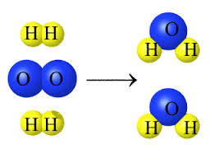
Daily Review
Balancing Formula Equations
List the number of each type of element on both sides of the equation.
Choose an element that has unequal numbers
Add coefficients to make them equal and adjust the numbers of elements in the list.
Choose another element that has unequal numbers, add coefficients and adjust the list.
Continue until all elements have equal numbers.
Oxygen + Hydrogen → Water
O₂ + H₂ → H₂O
2
2
O = 2
H = 2
O = 1
H = 2
2
4
4

Slide 31
Daily Review
Balancing Formula Equations
List the number of each type of element on both sides of the equation.
Choose an element that has unequal numbers
Add coefficients to make them equal and adjust the numbers of elements in the list.
Choose another element that has unequal numbers, add coefficients and adjust the list.
Continue until all elements have equal numbers.
Aluminium + Chlorine → Aluminium chloride
Al + Cl₂ → AlCl₃
2
3
2
Al = 1
Cl = 2
2
Al = 1
Cl = 3
2
6
6

